Slide 1
Office of Educator Effectiveness
Yenetta Harper, Director
October 2023

Slide 2
Ohio Teacher of the Year ORC 3319.67
​The Ohio Teacher of the Year program annually identifies exceptional teachers statewide celebrating their effective work in and outside the classroom.
Notes:
Elevates the teaching profession by providing opportunities for professional growth to a cohort of teachers who are leaders and advocates for public education through two tiers of recognition:
​
Teacher of the Year ORC 3319.67​
Ohio MISSION: Elevate the teaching profession by providing opportunities for professional growth to a cohort of teachers who are leaders and advocates for public education through two tiers of recognition: ​
(Regional) State Board District Teacher of the Year Cohort​
(State) Ohio Teacher of the Year​
​
The State Board District Teacher of the Year Cohort receives a grant through Martha Holden Jennings Foundation to participate in Action Research supported by Cleveland State University, They are invited to engage with the Teacher Leader Liaison Network and are members of the National Network of State Teachers of the Year (NNSTOY) along with the OH Chapter of NNSTOY.​
The Ohio Teacher of the Year participates in the following asynchronous experiences:​
Year 1 - Recognition and Professional Development through the Ohio and National Teacher of the Year programs​
Year 2 - Teacher Fellowship with the Ohio Department of Education ​
​
OEE runs this program as an affiliate of the National Teacher of the Year program supported by the Council of Chief State School Officers (CCSSO)​
​

Slide 3
Notes:
Announce this bring hot cards.
This is a great opportunity to honor those teachers who are going great work everyday for students please share this opportunity with your districts.

Slide 4
OAE
OAE 190 foundations of reading January 2023

Slide 5
OAE Results Analyzer
Data Interpretation: The OAE Results Analyzer helps educators make sense of assessment data by providing detailed information on individual and group performance.
Customizable Reports: Users can generate customizable reports to focus on specific aspects of the assessment results, such as content domains or performance by student demographics.
Comparative Analysis: The tool allows for comparisons across different groups, such as comparing student performance over time or against statewide averages.
Professional Development Insights: It provides insights into areas where educators may need professional development to improve student outcomes.
Notes:
Explain that the OAE (Ohio Assessments for Educators) Results Analyzer is a specific tool designed to help educators interpret and analyze assessment results.

Slide 6
OAE Results Analyzer Benefits
Informed Decision-Making: Educators can use the tool to make data-driven decisions about curriculum, instruction, and professional development.
Targeted Interventions: It helps identify areas where students may need additional support or intervention.
Accountability: Schools and districts can use the tool to track progress toward educational goals and accountability measures.

Slide 7
Resident Educator
Resident Educator Program Two Years
Resident Educator Summative Assessment (RESA)
Mentoring, Performance, Counseling
Notes:
[When presenting, this slide requires multiple clicks to reveal each element]
The resident educator program is two years
The RESA will still be required
The requirements of the program have been streamlined.
A work group of various stake holder worked over the last 24 months to make sure the program meets the needs of
Unlimited tries

Slide 8
Resident Educator Support
Resident Educator Program | Ohio Department of Education
REProgram@education.ohio.gov 1-877-644-6338
Notes:
We are here to help you please contact us for questions, concerns, and training needs.

Slide 9
Educator Evaluations
Ohio Teacher Evaluation
Ohio Principal Evaluation
School Counselor Evaluation
Superintendent Evaluations
OhioES
Credentialing

Slide 10
Support Specialist
TOM ROUNDS 216-544-6564 thomas.rounds@education.ohio.gov CATHRYN SHAW 740-703-5844 Cathryn.Everidge-Shaw@education.ohio.gov

Slide 11
Contact Information
EDUCATOR EVALUATION
OTES 2.0, OPES 2.0, OSCES
evaluation@education.ohio.gov OhioES OhioES@education.ohio.gov (P) 614-752-1333 (P) 614-387-0416
OHIOES - TECHNICAL SUPPORT
(P) 1-877-314-1412 support@ohioes.com

Slide 12
Notes:
Another resource we have
The HCRC is a website and center that has free resources for districts and schools to help manage the human capital system (attracting, recruiting, and retaining, rewarding). It focuses on moving from transactional HR to a more strategic systematic approach
The Resource Center gives you the tools and materials you need to make decisions from attracting and recruiting educators to supporting them throughout their careers.
The HCRC is for Building leaders, teacher leaders, coaches, central office supt.

Slide 13
Academic Success for All Equity Gap Analysis Tool
Notes:
These components reflect the learning conditions that ensure the success for all children achievement.
Culturally Responsive Practice – A student is likely to do better academically if the education experience is responsive to the child’s cultural identity. The goal is for each child to have access to educators who understand and incorporate each student’s cultural and linguistic knowledge into their practice and holds them to high expectations. Culturally responsive educators also understand how their own culture shapes their approach to teaching and learning.
Student-Centered Learning – When a student is given the opportunity to be involved in shaping his or her learning experience, he or she is more likely to be engaged and successful. The goal is for each child to have access to teachers who adapt their instruction based on students’ interests, strengths and needs, allowing students to take greater ownership of their learning.
Diverse Staff of Excellent Educators – A student is more likely to perform well academically if he or she sees teachers and other educators that reflect the student’s identity. The goal is for each child to have opportunities to engage with effective, experienced and properly certified educators who come from a variety of backgrounds (race, gender, ethnicity, language, disability, family background and/or income) who are intentionally hired, placed and supported by school and district leadership and staff with student success in mind.
Family & Community Engagement – A child’s academic achievement is enhanced when family and community are engaged in supporting a child’s education. The goal is for each child to receive tailored support to be successful through meaningful partnerships built on trust between educators, family and the community.
School Climate – When a child feels socially, emotionally and physically safe he or she will have a more successful educational experience and achieve higher academic outcomes. It is important for educators, students and families to nurture an environment of care and respect. Every member of the school community contributes to maintaining school operations and the physical environment.
Equity Gap Analysis Tool – The district might want to consider using the EGAT, particularly the Diverse Staff of Excellent Educators component, with the elementary. If the entire staff is female, there is a gap in that component.

Slide 14
Mentoring Guide
Notes:
designed to promote conversations and build relationships as well as provide introductory vocabulary and practical support. The guide is grounded in research showing that creating an alliance with a mentor where culture is respected reciprocally increases teacher re
retention.
Actionable practice and tools to apply knowledge in mentoring relationships including reflections on pedagogy and strategy to increase efficacy
Intended Impact: Retention and mentor growth
A tool in the RE program
Resident Educator Materials – Because Lucas is still in the RE program, he will need a mentor to work with him to complete and move to his first full license.

Slide 15
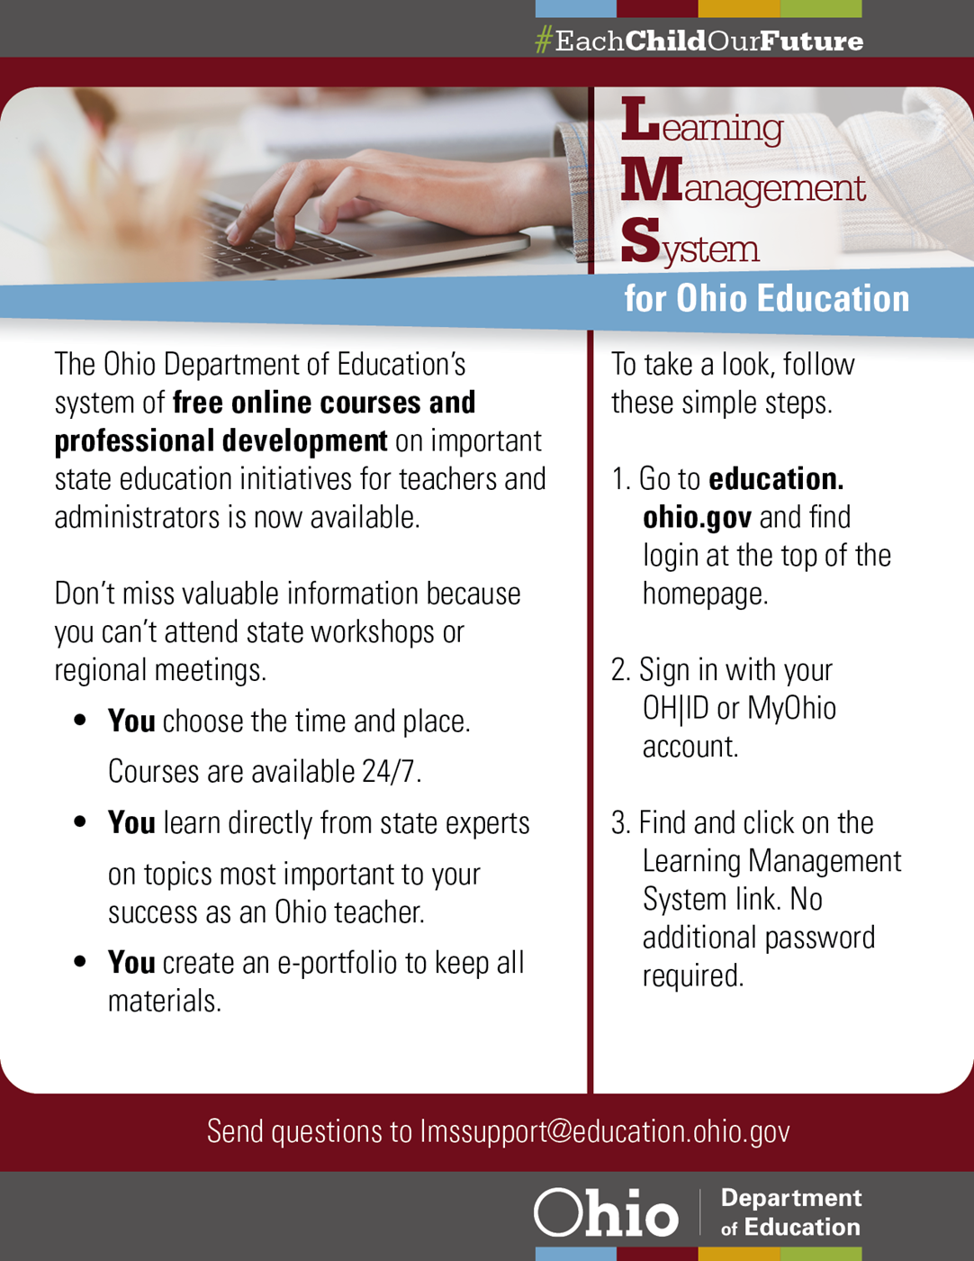
Culturally Responsive Pedagogy
Notes:
he LMS provides a variety of free courses and professional development on important state education initiatives. Featured courses include: ​High-Quality Professional Development (HQPD)
Coaching for Self-Reflection and Instructional Change
Assessment Literacy
Positive Behavioral Interventions and Supports (PBIS)
Culturally Responsive Practices (CRP): Program Introduction (Begin CRP Program Here) No .5 Culturally Responsive Practices (CRP): Cultural Responsiveness (Course 1) No 2.5 – 3 Culturally Responsive Practices (CRP): Socio-Political Awareness (Course 2) No 2 Culturally Responsive Practices (CRP): Academic Achievement (Course 3) No 4.5 - 5

Slide 16
@OHEducation

Slide 17
Office of Educator Licensure
Thomas McGee
September 2023

Slide 18
Office of Educator Licensure
Licensure Overview
Licensure Pathways
Office Overview
Licensure Data
Data Insights: Teacher Workforce
Notes:
Welcome to the Office of Educator Licensure! We appreciate the opportunity to share with you about our office. This presentation will provide a brief overview that will include information about licensure standards, who we serve, the different types of credentials we issue, the different pathways to licensure and of course, our unmatched customer service!

Slide 19
Licensure Standards
Competent teachers and student support personnel contribute to student success.
Ohio Revised Code and Ohio Administrative Code define licensure standards.
These standards strive for excellence by requiring completion of effective preparation programs, licensure exams, coursework requirements and background checks.
Notes:
Because competent teachers contribute to a child’s success in school, the Office of Educator Licensure works to ensure that Ohio students have highly effective teachers in their classrooms as well as excellent student support personnel and administrators in their buildings. Our office uses standards for licensure as defined in Ohio Revised Code and Ohio Administrative Code. These are rules that outline the requirements for licensure. They include completion of effective educator preparation programs, licensure exams and coursework requirements. Additionally, we want to ensure the safety of students, so Ohio law also includes requirements for criminal background checks at the time candidates apply for their first Ohio license or permit and every five years after that license or permit is issued.

Slide 20
Credential Types
Teaching Licenses & Permits
Administrative Licenses
Support Services Licenses, Registrations & Permits
Notes:
The Office of Educator Licensure also issues licenses. In 2021 our office issued 140,502 licenses, registrations and permits for teachers, administrators, and support services personnel (such as school counselors, instructional assistants and interpreters for the hearing impaired).

Slide 21
Teaching Licenses & Permits
12-Hour Teaching Permits
40-Hour STEM School Teaching Permits
40-Hour Industry Recognized Credential Career-Technical Workforce Development Teaching Permits
Adult Education Permits
Associate Teaching Licenses
Career-Technical Workforce Development Licenses
Early College High School Teaching Licenses
Permanent Non-Tax Certificates
Professional Educator Licenses (Including Senior & Lead)
Provisional STEM Teaching Licenses
Reinstatement Licenses
Resident Educator Licenses (Standard & Alternative)
Substitute Teaching Licenses
Supplemental Teaching Licenses
Temporary Teaching Licenses (Including Military & Out-of-State)
Visiting International Teaching Licenses
Notes:
Under Ohio law the Office of Educator Licensure issues 16 types of teaching licenses and permits to educators who work in Ohio schools and career centers.

Slide 22
Teaching Grade Level Bands
Primary Childhood (PK-5)*
Middle Childhood (4-9)*
Adolescence to Young Adult (7-12)*
Multi-Age (PK-12)
Primary Childhood Intervention Specialist (PK-5)
Intervention Specialist (K-12 and PK-12)
Career Technical (4-12)
Alternative
- Designated Subjects (K-12) - World Languages (PK-12) - Intervention Specialist (K-12)
Notes:
Teaching licenses are issued with both a grade band and teaching field, reflective of the subject area and student grade levels the educator has been prepared to teach.

Slide 23
Administrative Licenses
Administrative Specialist Licenses (Standard & Alternative)
Principal Licenses (Standard & Alternative)
Grades PreK-6
Grades 4-9
Grades 5-12
School Business Manager Licenses
School Treasurer Licenses
Superintendent Licenses (Standard & Alternative)
Notes:
We also issue licenses for school administrators. These include central office personnel or administrative specialists, as well as principals, school business managers, treasurers and superintendents. There are two pathways to licensure for Administrative Specialists, Principals and Superintendents, which we will review a little later in this presentation.

Slide 24
Support Service Licenses, Registrations & Permits
Coaching Permits
Educational Aide & Student Monitor Permits
Instructional Assistants (Autism Scholarship Providers)
Interpreter for Hearing-Impaired Licenses
Occupational Therapist & Assistant Licenses & Registrations
Orientation & Mobility Specialist Licenses
Physical Therapist & Assistant Licenses & Registrations
School Audiologist Licenses & Registrations
School Counselor Licenses
School Nurse Licenses & Registrations
School Psychologist Licenses
School Social Worker Licenses & Registrations
School Speech-Language Pathologist Licenses & Registrations
Temporary Pupil Services Licenses
Notes:
Additionally, we issue a variety of student support personnel licenses, registrations and permits, including coaching and educational aide permits, licenses for school nurses and registrations for school speech-language pathologists.

Slide 25
Pathways to Licensure
Traditional
Alternative
Supplemental
Notes:
Next, we’ll review pathways to licensure. Teacher candidates in Ohio also have three conventional pathways available to pursue licensure: traditional, alternative and supplemental.

Slide 26
Traditional Pathway (In State)
Over 60 colleges & universities
Over 2000 Ohio Department of Higher Education approved educator preparation programs
Some out-of-state, online programs available
Notes:
The traditional pathway is completed through an accredited college or university that is approved to prepare educators and administrators. Licensure candidates may choose from over 2000 Ohio Department of Higher Education-approved educator preparation programs at over 60 colleges and universities.

Slide 27
Traditional Pathway (Out-of-State)
Traditional university educator preparation programs honored
Exam and coursework requirements may apply
Flexibility through 1 Year Out-of-State licenses and Resident Educator or Professional licenses issued with reading and phonics coursework limitations
Notes:
Candidates who complete traditional educator preparation programs through out-of-state universities (other than those with programs approved by the Ohio Dept. of Higher Education) may also apply to be reviewed for Ohio licensure. Some candidates may need to complete additional exams or reading coursework, in accordance with Ohio Revised Code and Administrative Code. Our office provides flexibility in these cases by offering the 1 Year Out-of-State license to candidates who need a teaching license to work in an Ohio school while completing Ohio licensure exam requirements. Additionally, we issue licenses to candidates who have completed at least half of the 12 semester-hour reading and phonics coursework requirements for middle childhood, primary and intervention specialist licensure areas. The remaining coursework requirements are listed as limitations on the license, which are to be completed before the license expiration date.

Slide 28
Alternative Pathway
Available for teacher candidates & administrators
Accelerated pathway requiring exams, training and mentorship
Licenses issued only at the request of employing Ohio school districts
Notes:
The alternative pathway is an accelerated pathway to licensure for teacher candidates and administrators. This is a great option for individuals who already have a bachelor’s or master’s degree and are seeking a second career in education. Candidates who pursue this pathway will complete exam and training requirements and participate in a mentorship program in the Ohio school or district in which they work. Alternative licenses are valid only in the employing Ohio school or district. There are also GPA requirements for alternative administrators and teachers, which we will review next.

Slide 29
Alternative Resident Educator Pathway
Designated Subject Areas
Intervention Specialist Areas
World Languages
Degree & GPA: Bachelor’s Degree with 2.5 GPA or Master’s Degree with 3.0 GPA
Notes:
Teacher candidates have over 30 subject areas to choose from in the Alternative Resident Educator licensure pathway, allowing them to find the right fit for their content-area knowledge and career experience. These areas include Designated classroom subjects such as Chemistry and Language Arts; Intervention Specialist areas such as Moderate to Intense and Hearing Impaired; and World Languages such as Spanish and Chinese. Candidates must have a bachelor’s degree with a grade point average (or GPA) of at least 2.5 or a master’s degree with a GPA of at least 3.0 from an accredited college or university to be eligible for the Alternative Resident Educator licensure pathway.

Slide 30
Alternative Administrator Pathway
Administrative Specialists
Minimum of a bachelor’s degree with 3.0 GPA and work experience required
Principals & Assistant Principals
Minimum of a bachelor’s degree with 3.0 GPA and work experience required
Superintendents & Assistant Superintendents
Minimum of a graduate degree with 3.0 GPA and work experience required
Notes:
School administrators may also seek licensure through Ohio’s alternative pathway, at the request of an employing Ohio school or district. Candidates who pursue this pathway will also complete exam and professional development or coursework requirements and participate in a mentorship program in the Ohio school or district in which they work. To be eligible for this pathway, Alternative Principal and Administrative Specialist candidates must have a minimum of a bachelor’s degree with a 3.0 GPA from an accredited college or university. Alternative Superintendent candidates must have a graduate degree with a minimum of a 3.0 GPA. All alternative administrator candidates must also have successful experience in administration, education or management.

Slide 31
Supplemental Pathway
Available for teachers who hold active, standard Ohio teaching licenses
Accelerated pathway requiring content area exam, pedagogy coursework and mentored teaching
Licenses issued at the request of employing Ohio school districts
Pathway may be completed in as little as two school years
Notes:
The supplemental pathway to licensure allows educators who already hold an active, standard Ohio teaching license to teach in another subject area, at the request of an employing Ohio school or district, while they complete requirements for the additional licensure area. Candidates who pursue this pathway will complete exam and coursework requirements and participate in a mentorship program in the Ohio school or district in which they work.

Slide 32
Supplemental Pathway
Adolescence to Young Adult (7-12)*
Career-Technical Workforce Development (4-12)
Primary Childhood (PreK-5)*
Endorsement Areas (PreK-12)
Intervention Specialist Areas
Middle Childhood (4-9)*
Multi-Age & World Languages (PreK-12)
Notes:
Whether they have been requested to teach elementary, a career-tech subject area or a world language, there are over 150 subject areas available through the supplemental licensure pathway to meet the needs of Ohio educators and the schools in which they teach.

Slide 33
Purpose Statement
The Office of Educator Licensure supports educators, schools and stakeholders through the development and implementation of clear and consistent licensure standards to promote student access to highly effective educators.

Slide 34
Applicants
Teachers
Administrators
Support Personnel
Office of Educator Licensure:
Who We Serve
Ed Prep Program Providers
Colleges & Universities
Ohio Alternative Licensure Institutes
Districts & ESCs
School Districts
Educational Service Centers (ESCs)
Local Professional Development Committees (LPDCs)
Notes:
The Office of Educator Licensure assists customers with technical support for online licensure applications and with eligibility requirements for licensure. Our customers include licensure applicants such as teachers, principals, educational aides, school counselors, coaches and so on. We also assist colleges and universities who provide educator preparation programs here in Ohio, and a few out-of-state online universities that offer Ohio Dept. of Higher Education-approved licensure programs. And we work with Ohio Dept. of Higher Education-approved Licensure Institutes that offer training to candidates completing the Ohio Alternative Resident Educator licensure pathway. And of course, we are here to assist superintendents and human resources directors in schools, districts and educational services centers and their local professional development committees with any questions they have about licensure requirements for their employees. All Ohio schools, districts, educational service centers and local professional development committees are assigned to an Education Program Specialist here in our office by region.

Slide 35
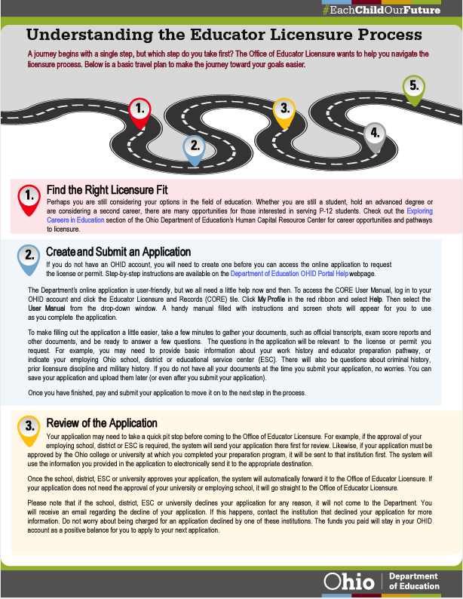

Slide 36
Licensure Application Process
Submit an Application
Eligibility Determination
Issuance of License
Determine the Appropriate License
Application
Review
Rapback Enrollment And Conduct Review

Slide 37
Total Number of Active Credentials
Notes:
*Total number of active credentials – 413,541
Important to Note That this is Different from Total Educators – 340,000

Slide 38
Credential issued By Year
Notes:
*Important to note a 36.6% increase from 2012 to 2022

Slide 39
Credentials Issued in 2022
Notes:
*Important to note that this breakdown would reflect differently from the overall numbers as licenses renewal at different times (Once every 5 years for teachers, 1 or 4 years for educators, etc)

Slide 40
2022 Total Year Data
Applications Processed:
168,480
Credentials Issued:
143,832
Licensure Calls Received:
30,339
Notes:
Excellent customer service is very important to our staff in the Office of Educator Licensure. In 2022 we processed over 168,000 licensure applications and issued over 143,000 licenses. We typically process applications within five business days, though processing times may be a few days longer during our peak processing season in the months of May through September. In addition to processing applications, our office received over 30,000 phone inquiries in 2022.

Slide 41
Application Requests Per Month

Slide 42
Average Initial Processing Time

Slide 43
Application Requests And Processing Time

Slide 44
Teacher Workforce Insights
Teacher shortages must be examined and understood locally.
Declining enrollment and stable teacher counts have led to historically low student-to-teacher ratios at the state level.
Regional areas of concern in these ratios when considering district type, grade band and subject: Southeast, Southwest and West JobsOhio regions.

Slide 45
Teacher Workforce Insights
Licensure and attrition trends impact local shortages.
Teachers without proper certification has increased.
Annual teacher attrition rate is slightly up at state level and is higher at the district level across Ohio.
Number of newly credentialed teachers has continued to decline after a period of recent stabilization.
There are tens of thousands of people with active Ohio teaching credentials who are not working in Ohio public schools (more than 43,000).

Slide 46
Gradual Decline of Newly Licensed Teachers Over the Decade
License Year | University Teacher Preparation Programs |  | Alternative Pathways | Total Newly Licensed Teachers
 | In Ohio | Out of State
2012 | 3,969 | 471 | 261 | 4,701
2013 | 6,414 | 892 | 328 | 7,634
2014 | 6,263 | 1,058 | 385 | 7,706
2015 | 5,505 | 955 | 489 | 6,949
2016 | 5,116 | 895 | 617 | 6,628
2017 | 4,667 | 727 | 478 | 5,872
2018 | 4,397 | 603 | 500 | 5,500
2019 | 4,228 | 573 | 533 | 5,334
2020 | 4,274 | 572 | 611 | 5,457
2021 | 4,530 | 393 | 465 | 5,388
2022 | 3,903 | 468 | 629 | 5,000

Slide 47
Relatively Stable Statewide Annual Attrition Rate for Teachers Since 2016
School Year | Exiting Teachers | Attrition Rate
2012 | 9,239 | 8.2%
2013 | 9,805 | 8.9%
2014 | 13,317 | 12.0%
2015 | 10,034 | 9.3%
2016 | 7,355 | 6.8%
2017 | 7,988 | 7.3%
2018 | 7,382 | 6.7%
2019 | 8,224 | 7.4%
2020 | 6,864 | 6.2%
2021* | 9,148 | 8.3%
*Individuals teaching in the 2020-2021 school year but not in the 2021-2022 school year.

Slide 48
Statewide Student-to-Teacher Ratios Decreased Over the Past Decade
School Year | Student FTE | Teacher FTE | Student to Teacher Ratio | Students with Disabilities FTE | Intervention Specialist FTE | Students with Disabilities to Teacher Ratio
2012 | 1,762,752 | 113,197 | 15.6 | 268,681 | 6,563 | 40.9
2013 | 1,747,172 | 111,717 | 15.6 | 262,477 | 7,355 | 35.7
2014 | 1,732,830 | 113,012 | 15.3 | 260,873 | 7,873 | 33.1
2015 | 1,739,120 | 108,244 | 16.1 | 256,951 | 8,287 | 31.0
2016 | 1,733,906 | 109,700 | 15.8 | 258,719 | 9,297 | 27.8
2017 | 1,718,756 | 110,248 | 15.6 | 254,695 | 9,988 | 25.5
2018 | 1,722,296 | 110,556 | 15.6 | 268,283 | 10,615 | 25.3
2019 | 1,716,312 | 111,388 | 15.4 | 272,069 | 11,018 | 24.7
2020 | 1,712,788 | 110,350 | 15.5 | 270,589 | 11,434 | 23.7
2021 | 1,663,975 | 110,882 | 15.0 | 266,816 | 11,974 | 22.3
2022 | 1,672,198 | 110,582 | 15.1 | 271,003 | 12,265 | 22.1

Slide 49
Credentialed Teachers Teaching and Working in Schools 2018 – 2022
Notes:
*Data are from CORE and EMIS. Data consists of headcounts of educators 1. working in any capacity in Ohio's public schools and 2. working as a teacher in OH public schools.
The Above graph addresses the gap between qualified educators and qualified educators willing to work for the conditions.
The blue bars represent the number of teachers working as teachers Ohio’s schools and districts for the last five years as teachers.
The grey bar in the middle represents the total number of licensed teachers working in Ohio in any position (administrators for example).
The red bar represents the total number of individuals holding an active teaching license in Ohio in the same year.
You can see that there almost 2 currently licensed teachers in Ohio for every 1 job. We do not necessarily lack qualified individuals (we lack individuals who are qualified and willing to work in education)
It is important to note that this only includes those with active licenses, people who could have immediately gone to work in any given year, if this were to be expanded to those with lapsed licenses, the data would be even more dramatic.

Slide 50
Willing To Work For The Conditions Offered
Compensation
Climate, Culture and Perception of the Profession
Implications for Recruitment and Retention
Notes:
Having Qualified Educators however is only one part of the equation, equally, if not more important, is the willingness to work for the conditions offered.
There are a significant number of factors that make up the conditions offered:
The first thing that generally comes to mind is compensation, and it is of course an important factor, but not the only factor.
Many educator report that the culture and perception of the profession are impacting their desire to stay in the profession. A huge number of factors go into this including:
Physical Working Conditions (Classroom and Building Environment)
Growth Potential (Career Ladders and the potential for professional development?)
Workload (Time for preparation, grading, and collaboration provided?)
Workplace Flexibility
Administrative Support
Many others
It is probably apparent that these factors will affect retention, but they also significantly impact recruitment. Educators who are not currently satisfied with their profession are going to be far less likely to advise their students to go into education. They also may discourage their children from becoming educators. Conversely, Educators satisfied with the profession are in the position to serve as ambassadors for the profession.
Important Note: As a result of the recent pandemic, Ohio is currently highly focused on ensuring that we are able to minimize the effects of the COVID interrupted learning. This goal must be held in mind when addressing the educator pipeline. It may be tempting to consider lowering licensure standards in order to inflate the number of licenses issued; however, research tells us the number one factor of student success is having a highly effective educator in the classroom. If we want to ensure that the Ohio school system can best support its students, we need to address the factors impacting the recruitment and retention of the best candidates.

Slide 51
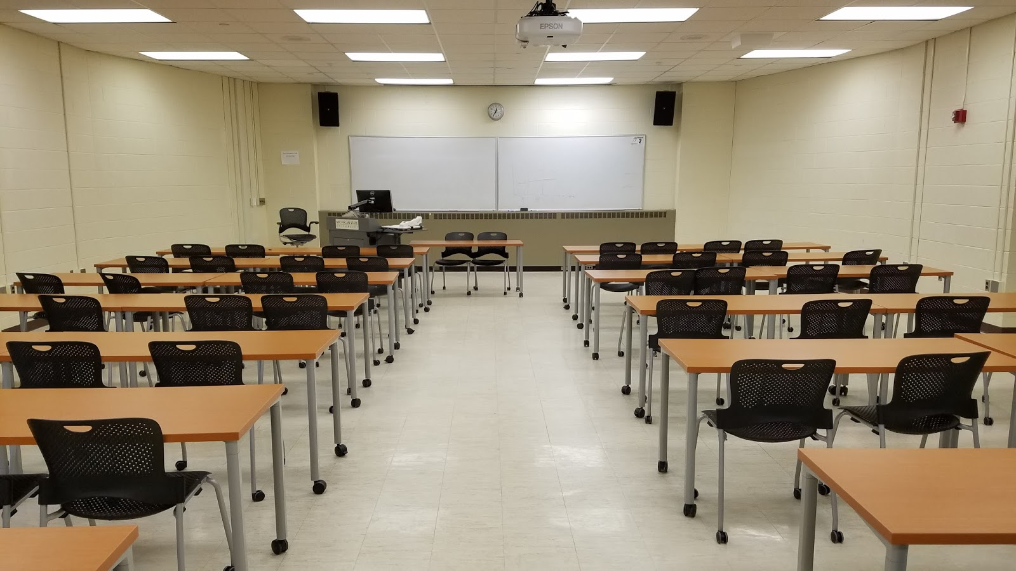
Teacher Workforce Initiatives
Reinstatement License
Ohio Educator Job Posting Board
Military Support for Licensure
Deans & State Leaders Collaborative
Teacher Apprenticeship

